Slide 1
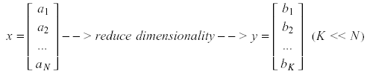
Principal Component Analysis (PCA)
Pattern recognition in high-dimensional spaces
Problems arise when performing recognition in a high-dimensional space (curse of dimensionality).
Significant improvements can be achieved by first mapping the data into a lower-dimensional sub-space.
The goal of PCA is to reduce the dimensionality of the data while retaining as much information as possible in the original dataset.

Slide 2
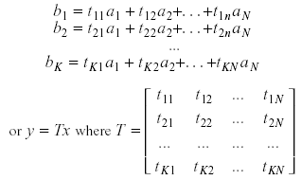
Principal Component Analysis (PCA)
Dimensionality reduction
PCA allows us to compute a linear transformation that maps data from a high dimensional space to a lower dimensional sub-space.
K x N

Slide 3


Principal Component Analysis (PCA)
Lower dimensionality basis
Approximate vectors by finding a basis in an appropriate lower dimensional space.
(1) Higher-dimensional space representation:
(2) Lower-dimensional space representation:

Slide 4
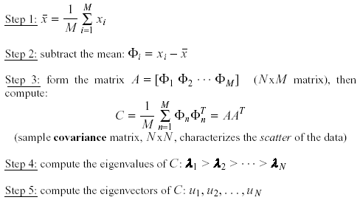
Principal Component Analysis (PCA)
Methodology
Suppose x₁, x₂, ..., x_{M} are N x 1 vectors
(i.e., center at zero)

Slide 5
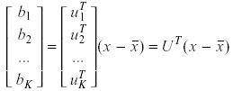
Principal Component Analysis (PCA)
Linear transformation implied by PCA
The effective linear transformation R^{N} → R^{K} that performs the dimensionality reduction is:
(i.e., simply computing coefficients of linear expansion)

Slide 6
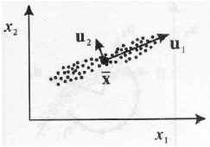
Principal Component Analysis (PCA)
Geometric interpretation
PCA projects the data along the directions where the data varies the most.
These directions are determined by the eigenvectors of the covariance matrix corresponding to the largest eigenvalues.
The magnitude of the eigenvalues corresponds to the variance of the data along the eigenvector directions.

Slide 7


Principal Component Analysis (PCA)
How to choose K (i.e., number of principal components) ?
To choose K, use the following criterion:
In this case, we say that we “preserve” 90% or 95% of the
information in our data. If K=N, then we “preserve” 100% of the information in our data.
PCA minimizes the reconstruction error, e, and it can be shown that the error is equal to:
➔

Slide 8

Principal Component Analysis (PCA)
What is the error due to dimensionality reduction?
The original vector x can be reconstructed using its principal components:
PCA minimizes the reconstruction error:
It can be shown that the error is equal to:

Slide 9

PCA Standardization
Standardization
The principal components are dependent on the units used to measure the original variables as well as on the range of values they assume.
Always standardize the data prior to using PCA.
A common standardization method is to transform all the data to have zero mean and unit standard deviation:

Slide 10
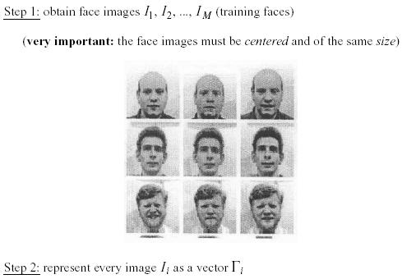
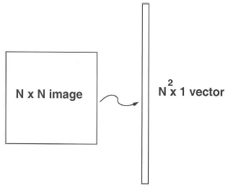
Application to Faces
Computation of low-dimensional basis (i.e.,eigenfaces):

Slide 11
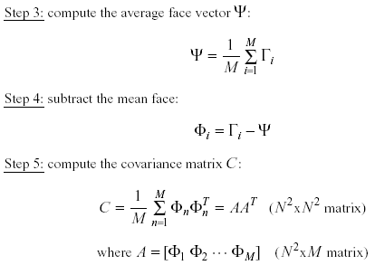
Application to Faces
Computation of the eigenfaces – contd…

Slide 12
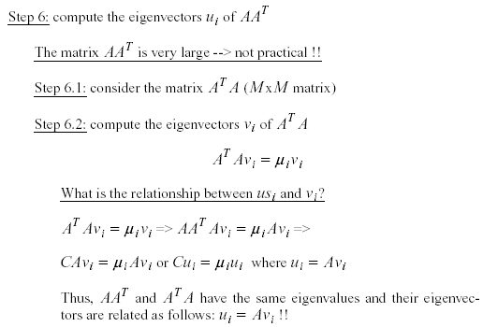
Application to Faces
Computation of the eigenfaces – contd...
u_{i}

Slide 13
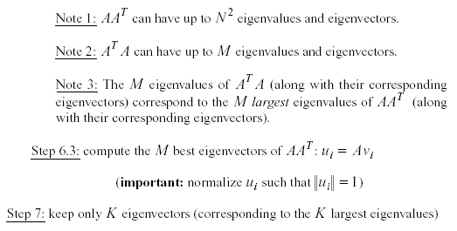
Application to Faces
Computation of the eigenfaces – contd..

Slide 14
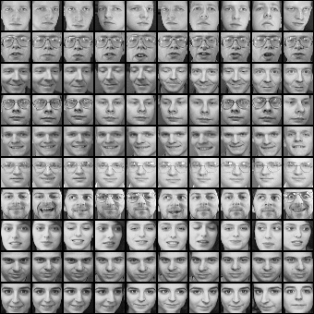
Eigenfaces example
Training images
Notes:
14

Slide 15
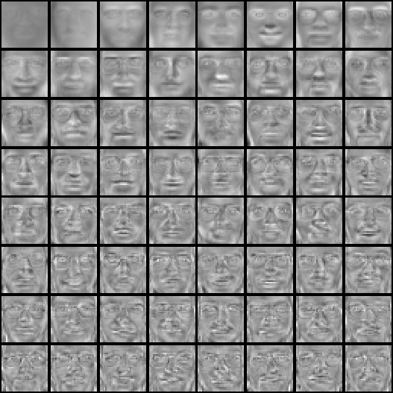

Eigenfaces example
Top eigenvectors: u₁,…u_{k}
Mean: μ
Notes:
15

Slide 16
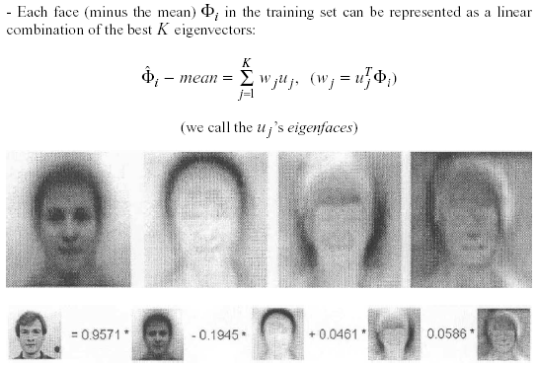
Application to Faces
Projecting faces onto the computed basis of Principal Components:
Face reconstruction:

Slide 17
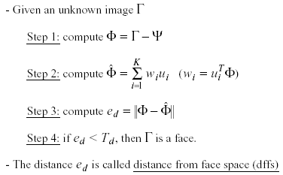
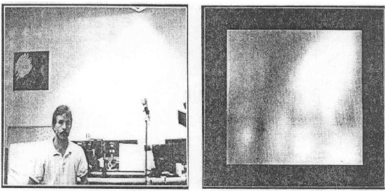
Eigenfaces for Face Detection
Visualization of DFFS:
The distance e_{d} is called distance from face space (DFFS) …
https://towardsdatascience.com/9-distance-measures-in-data-science-918109d069fa

Slide 18
Eigenfaces
Face detection, tracking, and recognition
Visualize dffs:

Slide 19
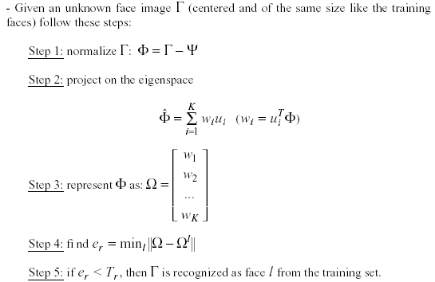
Eigenfaces for Face Recognition
where

Slide 20

Reconstruction using partial information
Robust to partial face occlusion:
Input Reconstructed

Slide 21
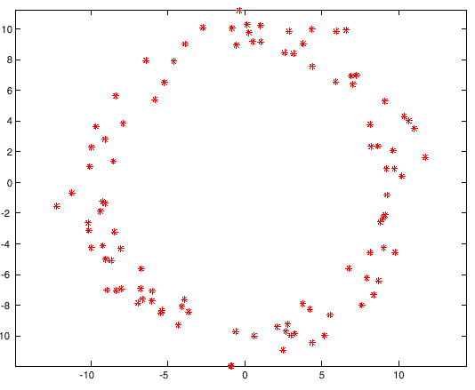
Eigen-Faces: Limitations
PCA assumes that the data follows a Gaussian distribution (mean µ, covariance matrix Σ)…
Eg: The shape of this dataset is not well described by its principal components –
Notes:
21

Slide 22
Eigen-Faces: Limitations
Background changes cause problems
De-emphasize the outside of the face (e.g., by multiplying the input image by a 2D Gaussian window centered on the face).
Light changes degrade performance
Light normalization helps.
Performance decreases quickly with changes to face size
Multi-scale eigenspaces.
Scale input image to multiple sizes.
Performance decreases with changes to face orientation (but not as fast as with scale changes)
Plane rotations are easier to handle.
Out-of-plane rotations are more difficult to handle.

Slide 23
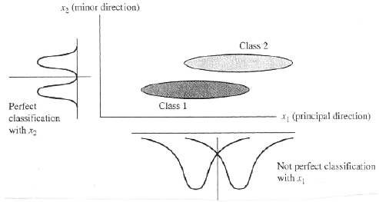
Eigen-Faces: Limitations
PCA is not always an optimal dimensionality-reduction procedure for classification purposes:
Solution..? Linear Discriminant Analysis! Next class…

